Slide 1
BLUETOOTH BASED WIRELESS HOME AUTOMATION SYSTEM USING FPGA
[ B. MURALI KRISHNA, V. NARASIMAHA NAYAK, K. RAVI KISHORE REDDY, B. RAKESH, P. MANOJ KUMAR, N.SANDHYA ]
Aagam Shah
Karan Shah
Pranav Shankar

Slide 2
Outline
Introduction
Xilinx EDK Design Flow
Hardware Design
Simulation Results
Relevance
Conclusion & Thoughts

Slide 3
Introduction

Slide 4
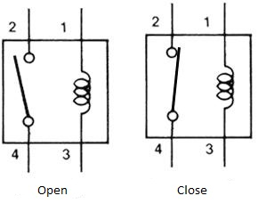
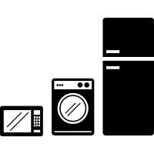
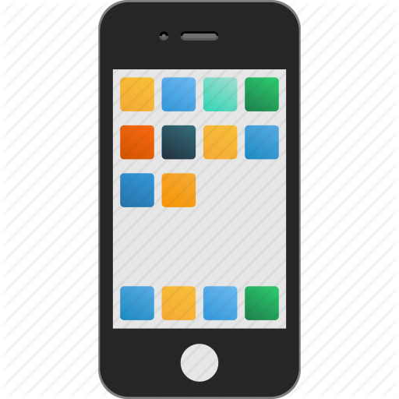
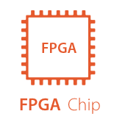

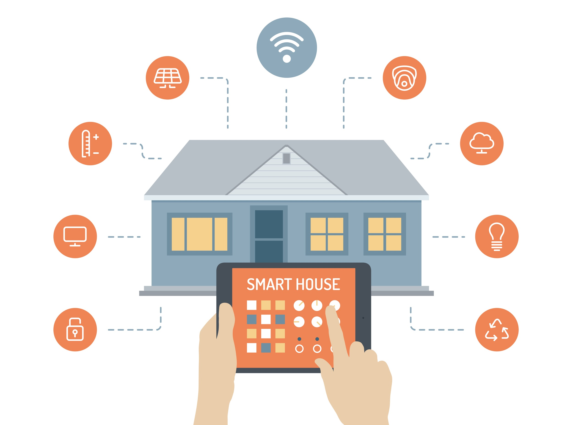

Slide 5
Xilinx EDK Design Flow

Slide 6

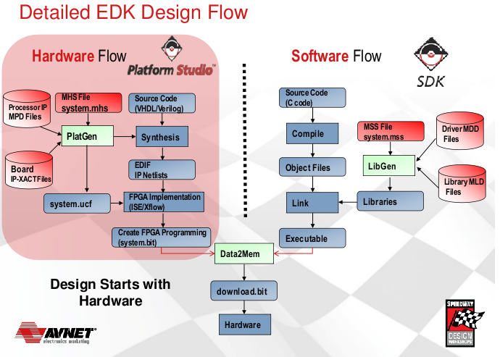
XILINX ISE
Used for circuit synthesis and design
Consists of
EDK (IPIF Library)
XPS < ---- > SDK

Slide 7
Design and Hardware

Slide 8
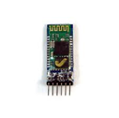
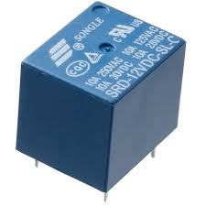
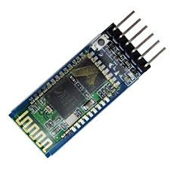
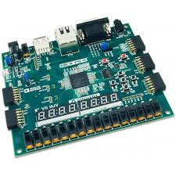
Hardware Design
Bluetooth Module
FPGA Board
Relay

Slide 9
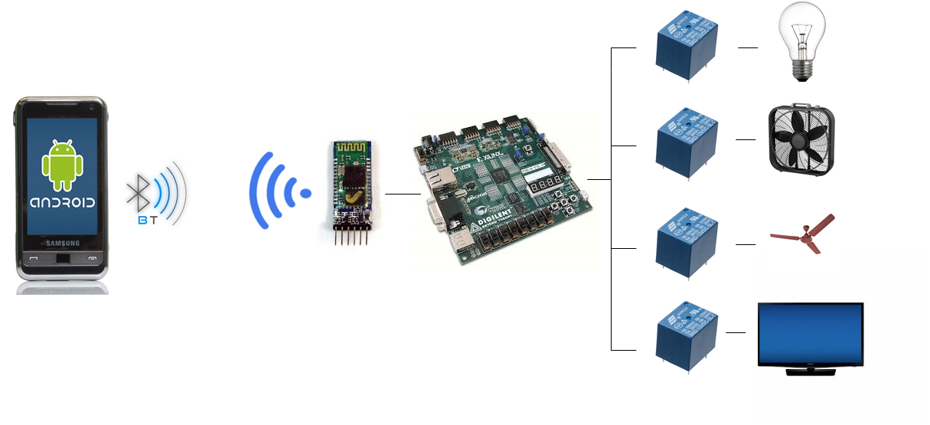
Architecture

Slide 10
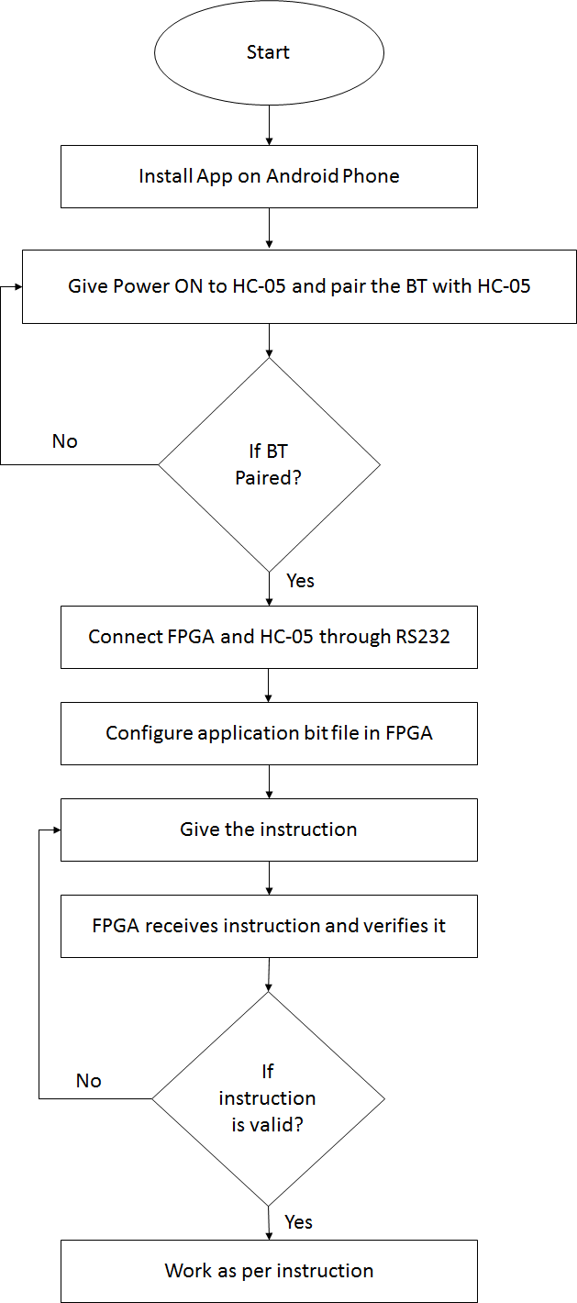
Algorithm
Notes:
Secured Password for connection between HC-05 and Phone
RS232 Serial Communication

Slide 11
Simulation Results

Slide 12
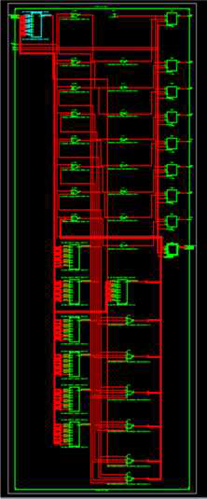
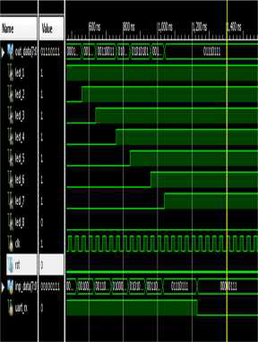
UART Rx Internal Schematic and Result

Slide 13
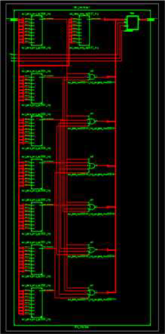
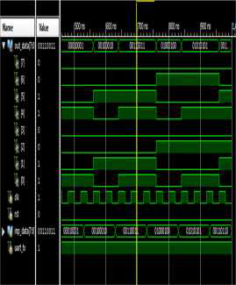
UART Tx Internal Schematic and Result

Slide 14
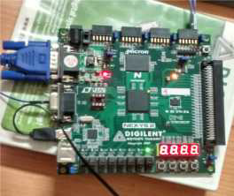
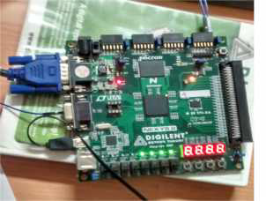
Final Output
When One Appliance Is ON
When 4 Appliances are ON

Slide 15
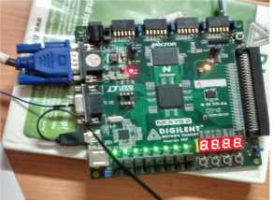
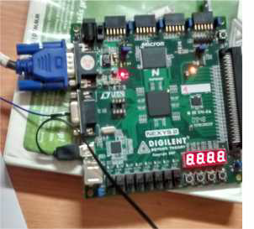
Final Output
When All Appliances are ON
When all Appliances are OFF

Slide 16
Conclusion & Thoughts

Slide 17
Conclusion
Proposed a smart home automation system:
operated by android smart phone,
using Bluetooth technology,
controlled through FPGA,
using relays
Analogy to our final project:
Smart phone → Website
Bluetooth → Cloud
FPGA → Raspberry Pi
Relays

Slide 18
Future Directions
FPGA:
More sophisticated device for the current application
Costly for smaller applications
Bluetooth:
Replace by cloud to have unrestricted access around the world
User Interface:
Better UI implementation
More functionalities added to the mobile UI

Slide 19
Questions??

Slide 20
Thank you

